Slide 1






ANNUAL REPORT-2018
Promoting Sustainable Development and Integration

Slide 2
Global growth continued to recover but pace of improvement is slowing
GDP Growth (% change) Source:IMF-WEO (April 2019)

Slide 3
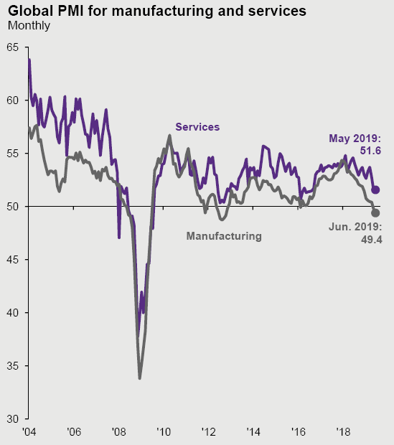
Global production and trade growth loses momentum
Global Manufacturing PMI at lowest level since October 2012

Slide 4
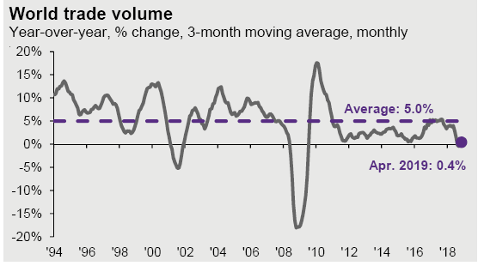
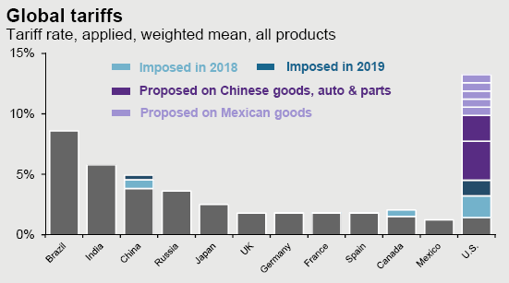
Role of trade driving global growth
WTO: World merchandise trade volume is forecasted to grow 2.7% in 2019 and 3% in 2020.

Slide 5
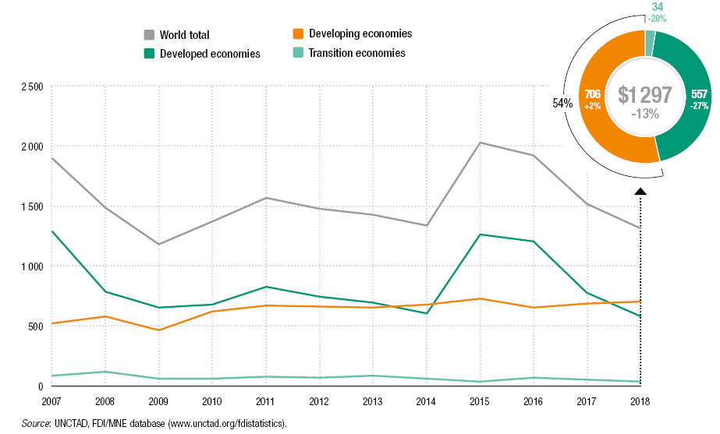
Global FDI flows continued to slide

Slide 6
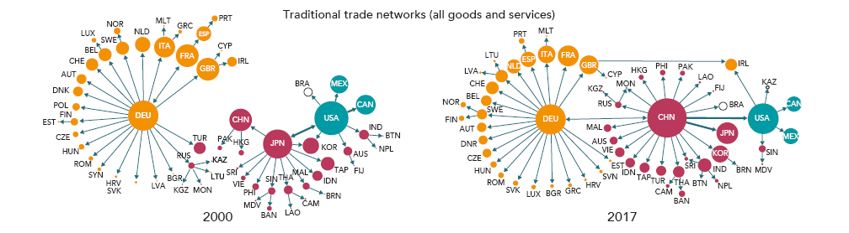
Change in global value-added chain
Source: Global Value Chain Development Report 2019

Slide 7
Risks on the sustainable global recovery
Protectionism trends in global trade
Geopolitical tensions
Normalization in monetary policies of advanced economies
Debt levels are rising in many advanced economies, and emerging markets
Higher borrowing costs
Increase in commodity prices
Weak productivity trends, technological innovation, big data and artificial intelligence,
Regulations on cyber-security, compliance, AML procedures, crypto-assets, payment systems including across borders, etc.
Notes:
IMF estimates that US-China tariffs, including those implemented last year, could reduce the level of global GDP by 0.5 percent in 2020 or about USD 455 bln.

Slide 8
Real GDP Growth rates of ECO Countries

Slide 9
Key Economic Indicators 2018
 | Real GDP Growth (percent) | Inflation (percent), average consumer | Central Gov. Budget Balance/ GDP (percent) | Current Account Balance/ GDP (percent) | Unemployment rate (%) | Foreign Direct Investment (USD mln) | Gross Government Debt/GDP (%)
Afghanistan | 2.3 | 0.6 | -0.9 | 4.7 | 8.8 | 0.13 | 7.0
Azerbaijan | 1.3 | 2.3 | 3.9 | 12.5 | 5.0 | 1.4 | 19.3
Iran | -3.9 | 31.1 | -3.8 | 4.3 | 13.9 | 3.4 | 33.1
Kazakhstan | 4.1 | 5.3 | 0.5 | 0.6 | 4.9 | 3.8 | 21.8
Kyrgyzstan | 3.4 | 1.5 | -1.3 | -9.8 | 6.8 | 0.04 | 56
Pakistan | 5.8 | 3.9 | -6.4 | -6.4 | 6.08 | 3.8 | 72.1
Tajikistan | 7.0 | 3.8 | -4.7 | -5.3 | NA | 0.3 | 47.8
Turkey | 2.6 | 16.3 | -3.6 | -3.5 | 10.8 | 6.5 | 32.6
Turkmenistan | 6.2 | 13.5 | 0.6 | 3.1 | NA | 1.9 | 29.2
Uzbekistan | 5.0 | 17.8 | 3.1 | -7.8 | NA | 0.4 | 23.5
ECO | 1.75 | 16.2 | -3.2 | -1.2 | - | 21.5 | -

Slide 10
ACHIEVEMENT OF STRATEGIC GOALS
Since 2008, total disbursed loans reached to USD 1.58 billion as end of December 2018.
Good asset quality with well diversified portfolio without any non-performing loans (NPLs)
Strenghthened the operating structure and processes
Various efficiency measures are employed
More lending rather than treasury placements
Improved the Enterprise-wide Risk Management (ERM) perspective
Expanded the membership base
Enhanced co-financing arrangements with IFC, BSTDB, EBRD, IsDB, ADB, etc.
Human resources and IT system capabilities are improved

Slide 11
Main Business Perspective
All operations are required to observe criteria set within the negative list of products policy, anti-money laundering regulations as well as environmental policy
Intermediated Operations through FIs
Trade Finance Credit Lines
SMEs Finance Loans
Microfinance Loans
Corporate Loans and Project Finance Operations
Guarantees
Tech. Asst. and advisory services

Slide 12
Total Loan disbursements by country 2008-2018 (thousand USD)
The Bank has successfully launched its credit operation in Azerbaijan and looking for opportunities in Afghanistan and Kyrgyzstan as well.

Slide 13
Portfolio Development 2014-2018
(SDR million)

Slide 14
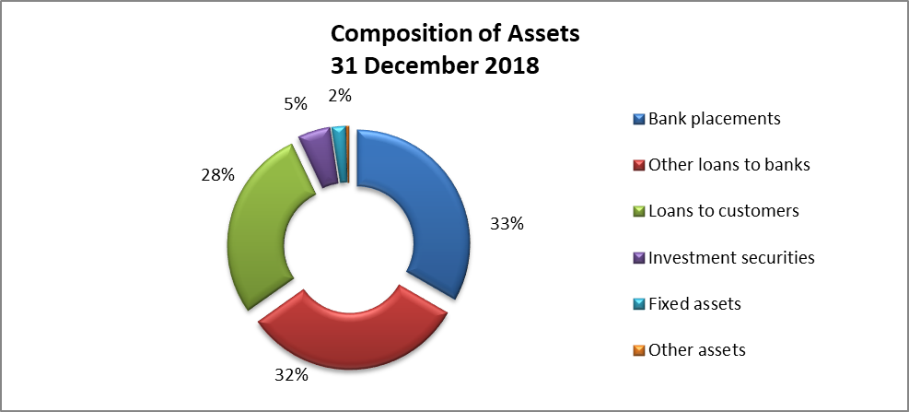
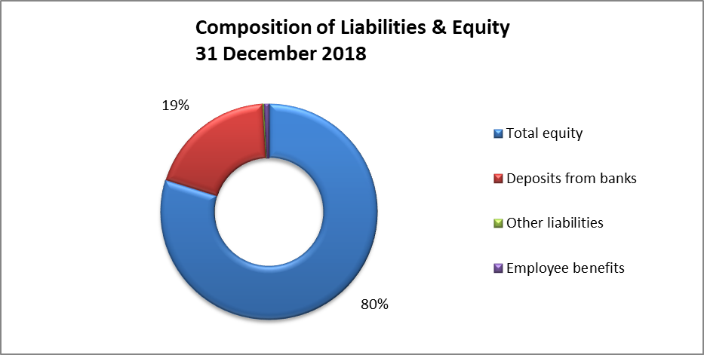
Financial Highlights
-Robust loan portfolio
-No NPLs
-Sustainable income
-RoE @ 2,5% (2018)

Slide 15
Challenges of the ETDB
Sustaining a high quality loan portfolio
Enhancing cooperation with the banks in the member states
Access to corresponding banking services
Enhancing the capital resources
Encouraging new members (Kazakhstan, Tajikistan, Turkmenistan and Uzbekistan)

Slide 16
Thank you....
___________________________________
www.etdb.org

