Slide 1






ANNUAL REPORT-2017
Promoting Sustainable Development and Integration

Slide 2
Global growth continued to recover and expected to remain strong
GDP Growth (% change) Source:IMF-WEO (April 2018)

Slide 3
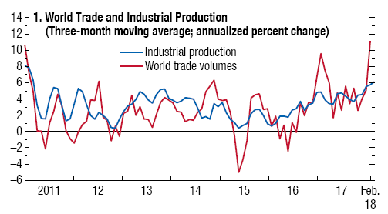
Growing trade and investment continue as notable factors powering the global economy
Source:IMF-WEO (April 2018)

Slide 4
Risks on the sustainable global recovery
Tighter global financial conditions
Normalization in monetary policies of advanced economies
Less available credit
Higher borrowing costs
Increase in commodity prices
Weak productivity trends
Protectionism trends in global trade
Geopolitical tensions

Slide 5
Real GDP Growth rates of ECO Countries

Slide 6
Key Economic Indicators 2017
 | Real GDP Growth (percent) | Inflation (percent), average consumer | Central Gov. Budget Balance/ GDP (percent) | Current Account Balance/ GDP (percent) | Unemployment rate (%) | Foreign Direct Investment (USD bn) | Gross Government Debt/GDP (%)
Afghanistan | 2.5 | 4.9 | -0.61 | 1.6 | NA | 0,05 | NA
Azerbaijan | 0.07 | 13 | 1.52 | 3.5 | 5.0 | 2,86 | 54.7
Iran | 4.2 | 9.8 | -2.3 | 4.2 | 11.8 | 5,01 | 40.8
Kazakhstan | 3.9 | 7.4 | -6.3 | -2.9 | 4.9 | 4,63 | 21.1
Kyrgyzstan | 4.5 | 3.2 | -3.3 | -7.7 | 7.1 | 0,09 | 59.0
Pakistan | 5.3 | 4.1 | -5.6 | -4.1 | 6.1 | 3,26 | 67.2
Tajikistan | 7.1 | 7.3 | -2.4 | -2.6 | 2.2 | 0,14 | 47.7
Turkey | 7.4 | 11.1 | -2.3 | -5.5 | 10.8 | 10,8 | 28.5
Turkmenistan | 6.5 | 8 | -2.8 | -11.5 | NA | 2,31 | 28.8
Uzbekistan | 5.3 | 12.5 | -1.7 | 3.7 | NA | 0,09 | 24.5
ECO | 5.5 | 9.1 | -3.1 | -2.5 | - | 29,2 | 37.1

Slide 7
ACHIEVEMENTS OF STRATEGIC GOALS: 2013-2017
Since 2008, total disbursed loans exceeded SDR 975 million (USD 1.4 billion) as end of December 2017.
Good asset quality with well diversified portfolio without any non-performing loans (NPLs)
Strenghthened the operating structure and processes
Various efficiency measures are employed
More lending rather than treasury placements
Improved the Enterprise-wide Risk Management (ERM) perspective
Expanded the membership base
Enhanced co-financing arrangements with IFC, BSTDB, EBRD, IsDB, ADB, etc.
Human resources and IT system capabilities are improved

Slide 8
Main Business Perspective
All operations are required to observe criteria set within the negative list of products policy, anti-money laundering regulations as well as environmental policy
Intermediated Operations through FIs
Trade Finance Credit Lines
SMEs Finance Loans
Microfinance Loans
Corporate Loans and Project Finance Operations
Guarantees
Tech. Asst. and advisory services

Slide 9
Total Loan disbursements by country 2008-2017 (thousand USD)
The Bank has successfully launched its credit operation in Azerbaijan and looking for opportunities in Afghanistan and Kyrgyzstan as well.

Slide 10
Portfolio Development 2013-2017
(SDR million)
Total Equity: SDR 373 million

Slide 11
Highlights of
Loan Operations-2017

Slide 12
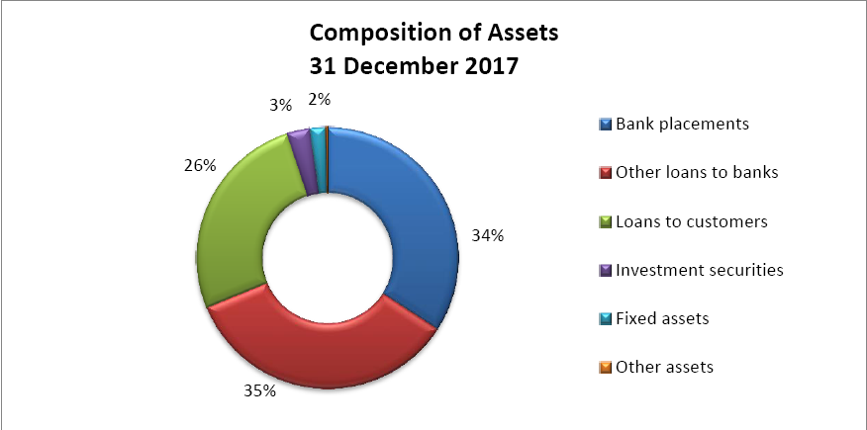
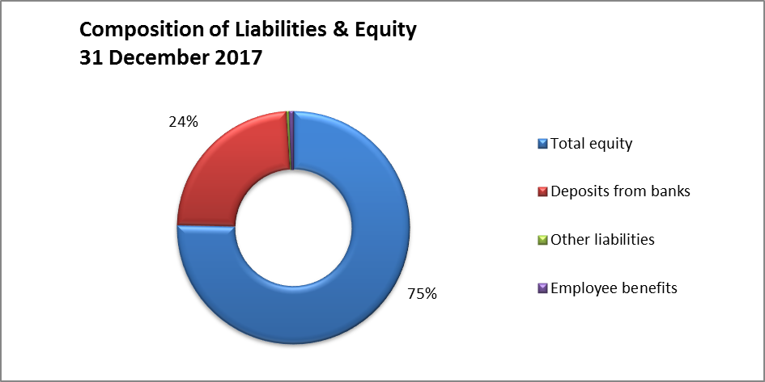
Financial Highlights
-Robust loan portfolio
-No NPLs
-Sustainable income
-RoE @ 2,7% (2017)

Slide 13
Challenges of the ETDB
Sustaining a high quality loan portfolio
Enhancing cooperation with the banks in the member states
Access to corresponding banking services
Enhancing the capital resources
Encouraging new members (Kazakhstan, Tajikistan, Turkmenistan and Uzbekistan)

Slide 14
Thank you....
___________________________________
www.etdb.org

